Slide 1
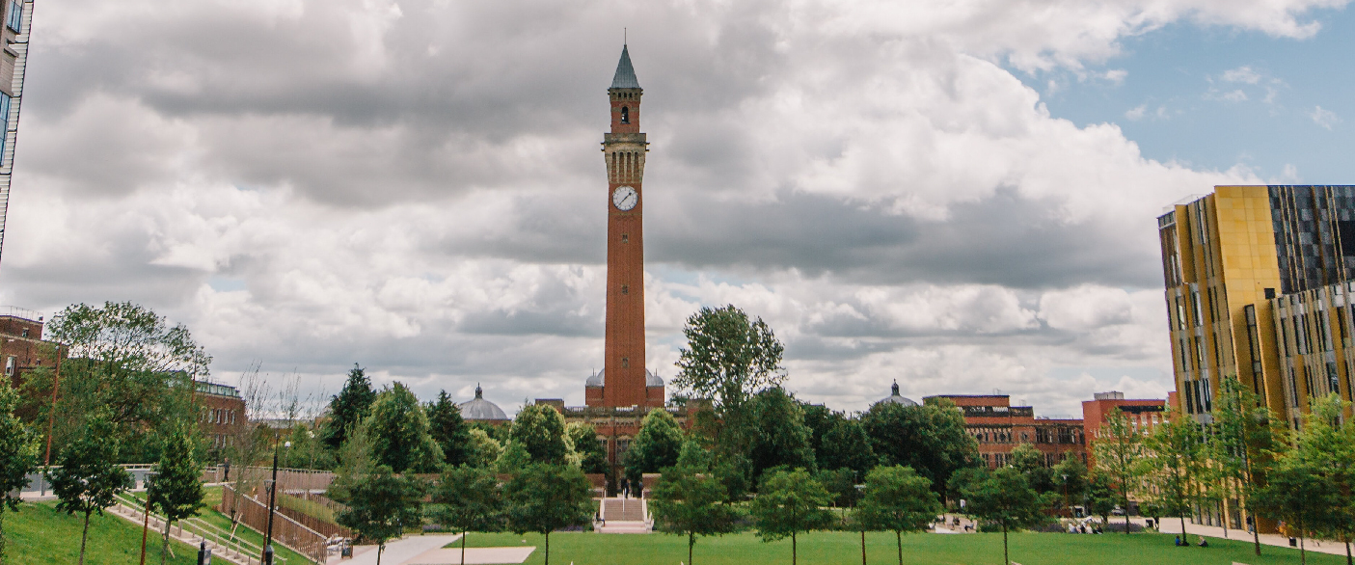
Plenary Speakers:
Gaia Tavosanis (RWTH University)
Bassem Hassan (Paris Brain Institute)
Fen-Biao Gao (Umass Chan Med Sch)
Hongyan Wang (Duke-NUS Med Sch)
Lars Chittka (Queen Mary Univ)
Florence Besse (Univ Côte d’Azur)
Bruno van Swinderen (University
of Queensland)
Irene Miguel-Aliaga (Imperial College)
20th Biennial European Drosophila Neurobiology Conference
University of Birmingham, UK
Website: neurofly2024.org

