Slide 1
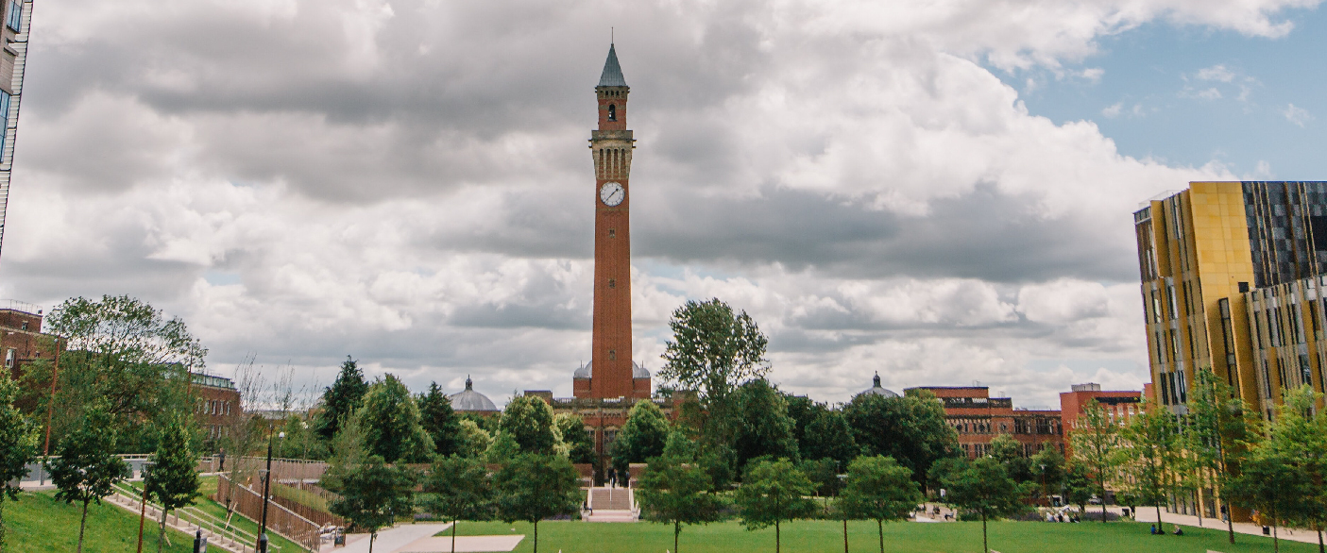
20th Biennial European Drosophila Neurobiology Conference
University of Birmingham, UK
Plenary Speakers:
Gaia Tavosanis (RWTH University, Germany)
Bassem Hassan (Paris Brain Institute, France)
Fen-Biao Gao (Umass Chan Medical School, US)
Hongyan Wang (Duke-NUS Med Sch, Singapore)
Lars Chittka (Queen Mary University, UK)
Florence Besse (Université Côte d’Azur, France)
Bruno van Swinderen (Univ of Queensland, Australia)
Irene Miguel-Aliaga (Imperial College London, UK)
Conference Organisers:
Alicia Hidalgo (Chair), Yun Fan,
Carolina Rezaval, Matthias Soller,
Richard Tuxworth
(University of Birmingham)
Matthias Landgraf (Cambridge)
Thomas Riemensperger (Cologne)
Natalia Sanchez Soriano (Liverpool)
Guy Tear (London)
Events management:
Louise Walczak, Samantha Oliver
(University of Birmingham)
Early bird registration deadline: 16 June 2024
Abstract deadline: 16 June 2024
Visit: neurofly2024.org

